Slide 1
Abstract Factory
Lecture 18

Slide 2
Intent
Abstract Factory is a creational design pattern that lets you produce families of related objects without specifying their concrete classes.

Slide 3
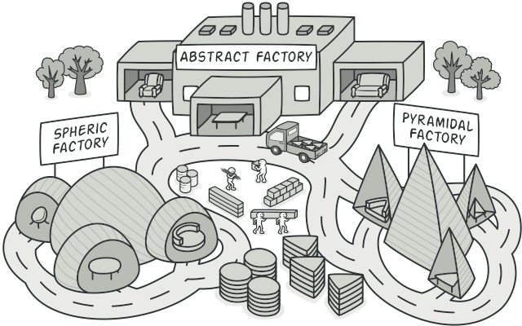

Slide 4
Problem
Imagine that you’re creating a furniture shop simulator. Your code consists of classes that represent:
A family of related products, say: Chair + Sofa + CoffeeTable.
Several variants of this family. For example, products Chair + Sofa + CoffeeTable are available in these variants:
Modern, Victorian, ArtDeco.

Slide 5
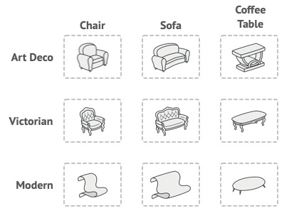

Slide 6
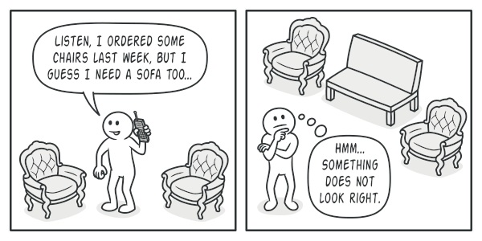

Slide 7
Problem
You need a way to create individual furniture objects so that they match other objects of the same family. Customers get quite mad when they receive non-matching furniture.
Also, you don’t want to change existing code when adding new products or families of products to the program. Furniture vendors update their catalogs very often, and you wouldn’t want to change the core code each time it happens.

Slide 8
Solution
The first thing the Abstract Factory pattern suggests is to explicitly declare interfaces for each distinct product of the product family (e.g., chair, sofa or coffee table).
Then you can make all variants of products follow those interfaces.
For example, all chair variants can implement the Chair interface; all coffee table variants can implement the CoffeeTable interface, and so on.

Slide 9
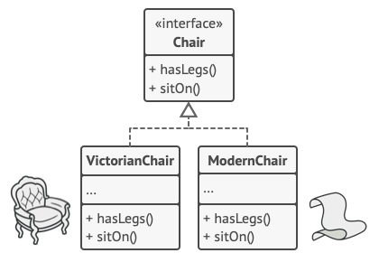

Slide 10
Solution
The next move is to declare the Abstract Factory—an interface with a list of creation methods for all products that are part of the product family (for example, createChair, createSofa and createCoffeeTable).
These methods must return abstract product types represented by the interfaces we extracted previously: Chair, Sofa, CoffeeTable and so on.

Slide 11
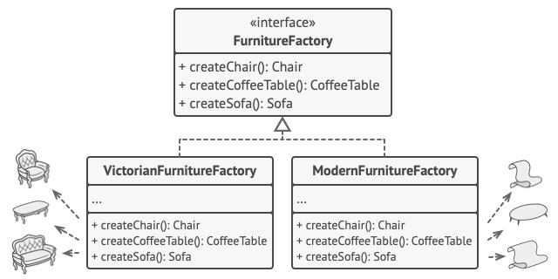

Slide 12
Explanation
Now, how about the product variants? For each variant of a product family, we create a separate factory class based on the AbstractFactory interface.
A factory is a class that returns products of a particular kind.
For example, the ModernFurnitureFactory can only create ModernChair, ModernSofa and ModernCoffeeTable objects.

Slide 13
Explanation
The client code has to work with both factories and products via their respective abstract interfaces.
This lets you change the type of a factory that you pass to the client code, as well as the product variant that the client code receives, without breaking the actual client code.

Slide 14
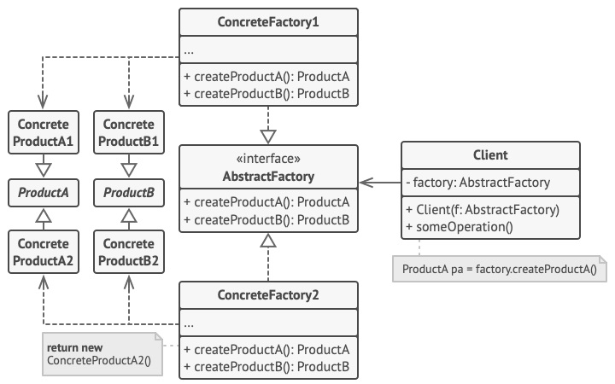

Slide 15
Structure
Step 1
Abstract Products declare interfaces for a set of distinct but related products which make up a product family.
Step 2
Concrete Products are various implementations of abstract products, grouped by variants. Each abstract product (chair/sofa) must be implemented in all given variants (Victorian/Modern).

Slide 16
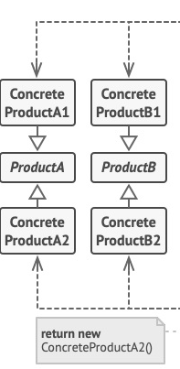

Slide 17
Structure
Step 3
The Abstract Factory interface declares a set of methods for creating each of the abstract products.
Step 4
Concrete Factories implement creation methods of the abstract factory. Each concrete factory corresponds to a specific variant of products and creates only those product variants.

Slide 18
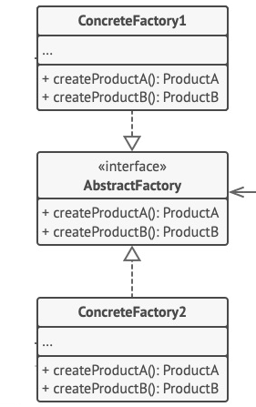

Slide 19
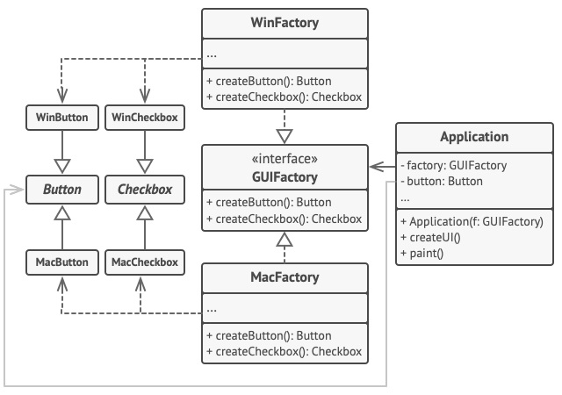

Slide 20

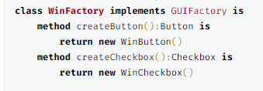

Pseudocode

Slide 21
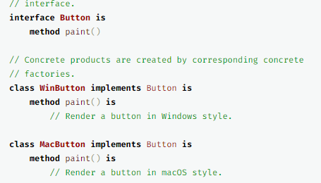
// Each concrete factory has a corresponding product variant.
class MacFactory implements GUIFactory is method createButton():Button is return new MacButton() method createCheckbox():Checkbox is return new MacCheckbox()

Slide 22
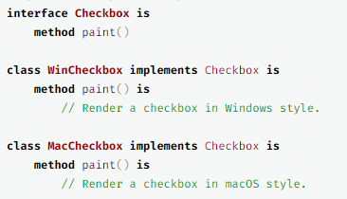

Slide 23
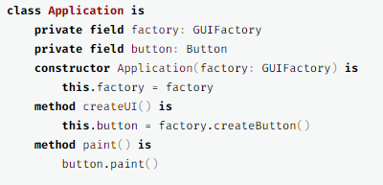

Slide 24
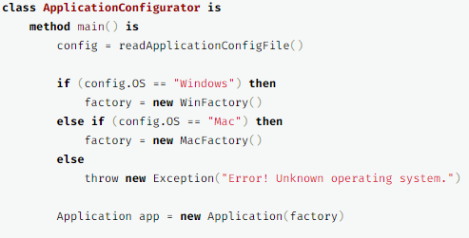

Slide 25
References
https://refactoring.guru/design-patterns/abstract-factory

